Slide 1
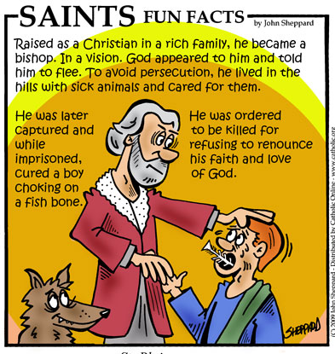
St Blaise Patron Saint of
Sore throats! Read the information in the picture
On this day people will have their throats blessed at the end of Mass
Wherever he went, to village, or town, or farm, they laid down the sick in the open spaces, begging him to let them touch even the fringe of his cloak. And all those who touched him were cured. (Gospel of Mark)
MISSION:
Father, may our voices be clear
to speak with words of justice and truth.
May we speak up for those
who have no voice in our world.
Amen
Discuss who are the voiceless in our world – how can we contribute to speaking up for them?

Slide 2
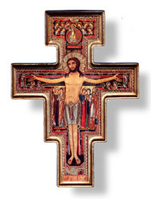
Our Father who art in heaven
hallowed be your name
your kingdom come,
your will be done
on earth as it is in heaven.
Give us this day, our daily bread
and forgive us our trespasses
as we forgive those who
trespass against us
and lead us not into temptation
but deliver us from evil.
Amen.
Glory be to the Father
and to The Son
and to the Holy Spirit
as it was in the beginning
is now and ever shall be
world without end. Amen.
Blessing 1 (for safety)
May God keep us safe from all harm today
May we learn more about the goodness in our hearts
And find God through all that happens.
Blessing 2 (for friendship and peace)
May we find peace today, peace to share with each other
May spiritual friendship grow between us
And kindness and cheerfulness support us all day.
And may God bless us all
In the name of the Father
And of the Son
And of the Holy Spirit
AMEN
Hail Mary full of grace
the Lord is with you
blessed are you among women
and blest is the fruit
of your womb, Jesus.
Holy Mary, mother of God
pray for us sinners, now
and at the hour of our death.
Amen.
SCHOOL PRAYER
This is what the Lord asks of you
to act justly, love tenderly,
and walk humbly with your God.
In the name of the Father & the Son & the Holy Spirit Amen
Go in the strength of God, now upholding you. (The Book of Judges)
Lord Jesus, continue to bless this day.
May we be a blessing to all who share our lives and our homes.
We say a prayer together
Glory be to the Father and to the Son & to the Holy Spirit, as it was in the beginning is now and ever shall be, world without end. Amen
The grace of our Lord Jesus Christ,
the Love of God and the
fellowship of the Holy Spirit
be with us all evermore. Amen
We end by praying together
The Lord bless us, and keep us from all evil, and bring us to
everlasting life.
Amen

Slide 3
……today is known as a 'Feria' day in Ordinary Time- that is a day where the whole Church doesn't celebrate a Feast day of Jesus or Mary or a Saints Day.
On these days the vestments at Mass are green – the sign of growth.
Yours, Lord, are greatness and power,
and splendour, triumph, and glory.
All is yours, in heaven and on earth.
(1 Chronicles)
MISSION:
Lord, help us to grow into the people
you wish us to be.
May our humility show
that you are at work within us.
Amen
Discuss who are the voiceless in our world – how can we contribute to speaking up for them?

Slide 4
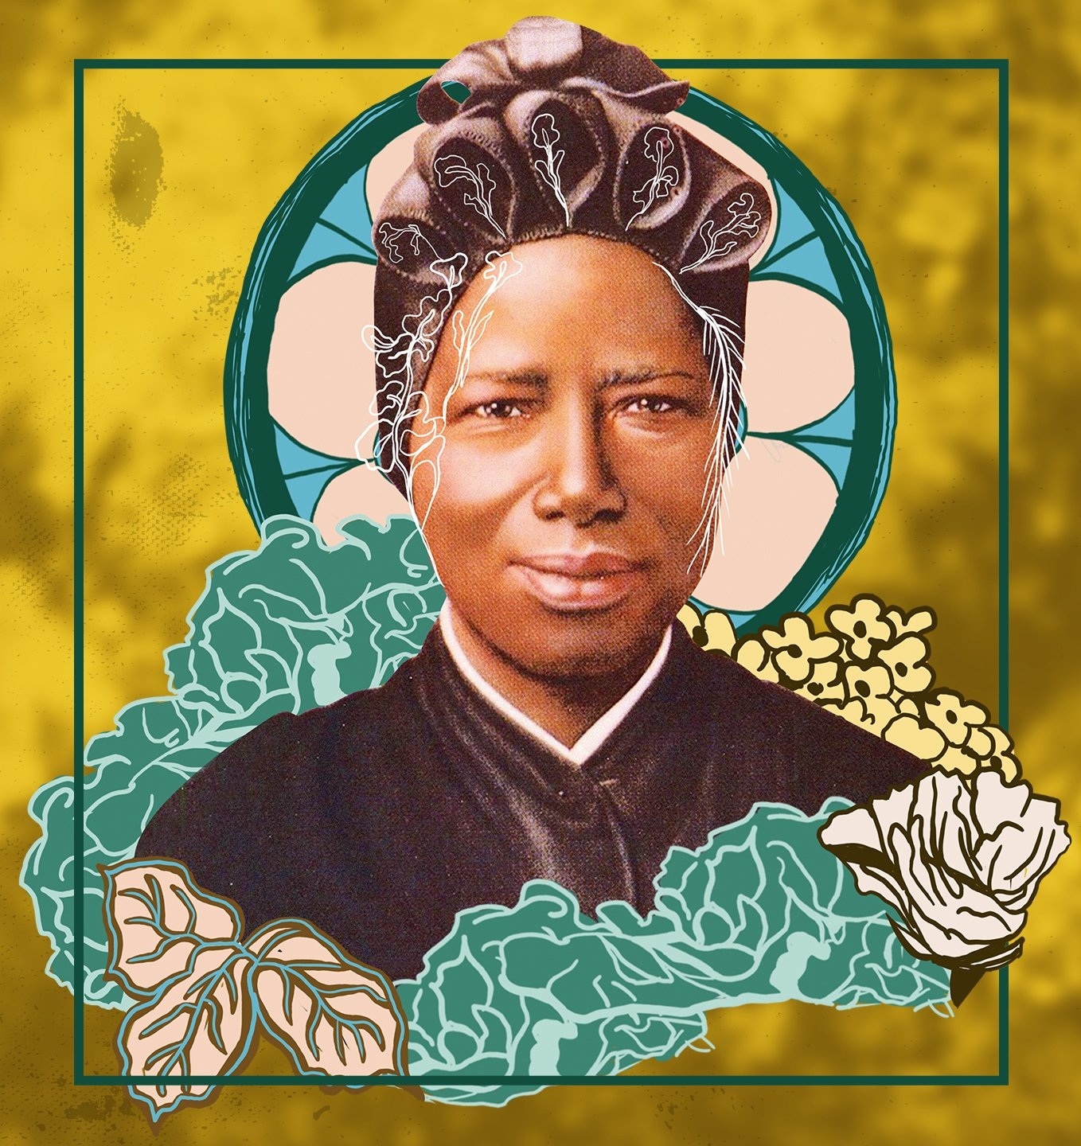
St Josephine Bakhita
Day of prayer for victims of human trafficking
Jesus said “This is my commandment,
that you love one another as I have loved you.’
(Gospel of John 15:12)
Father, you led St Josephine
from slavery to the dignity
of being your daughter.
Grant we pray that by her example
we will work for the dignity of all human life,
showing love and compassion to all.
Through Christ our Lord.
Amen
MISSION:
Discuss who are the voiceless in our world – how can we contribute to speaking up for them?

