Slide 1
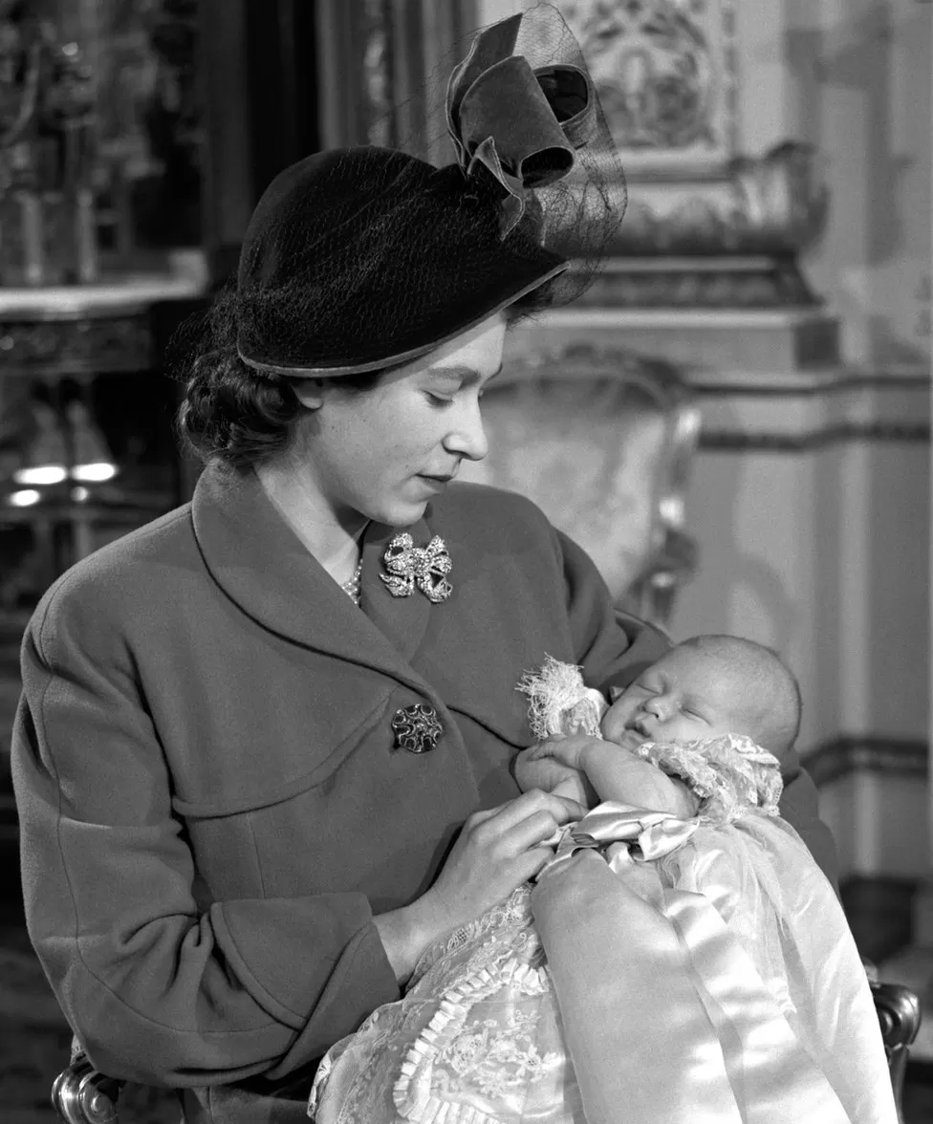
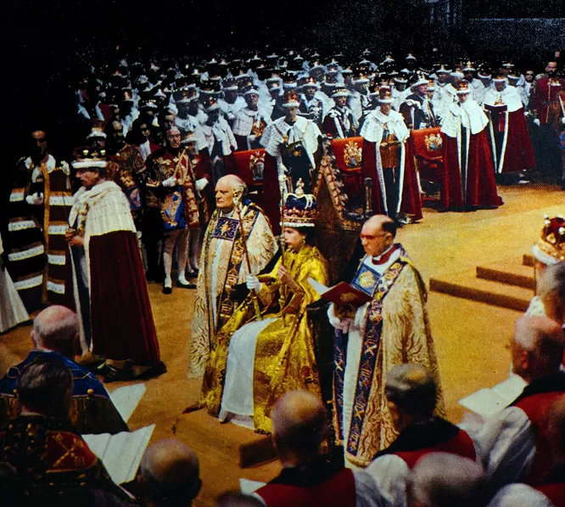
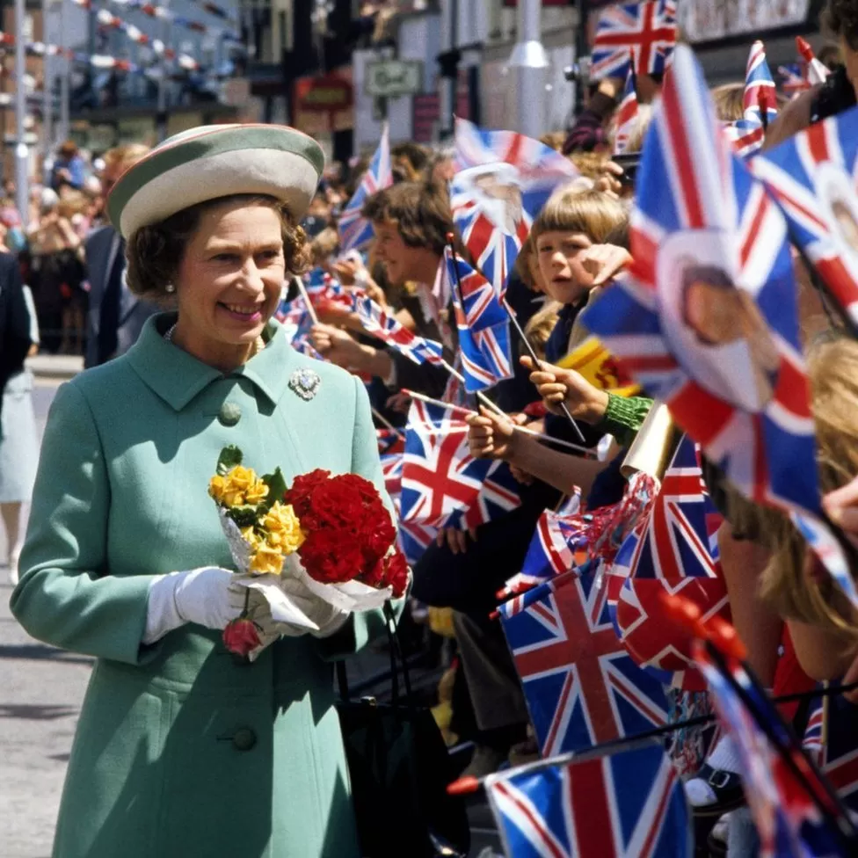
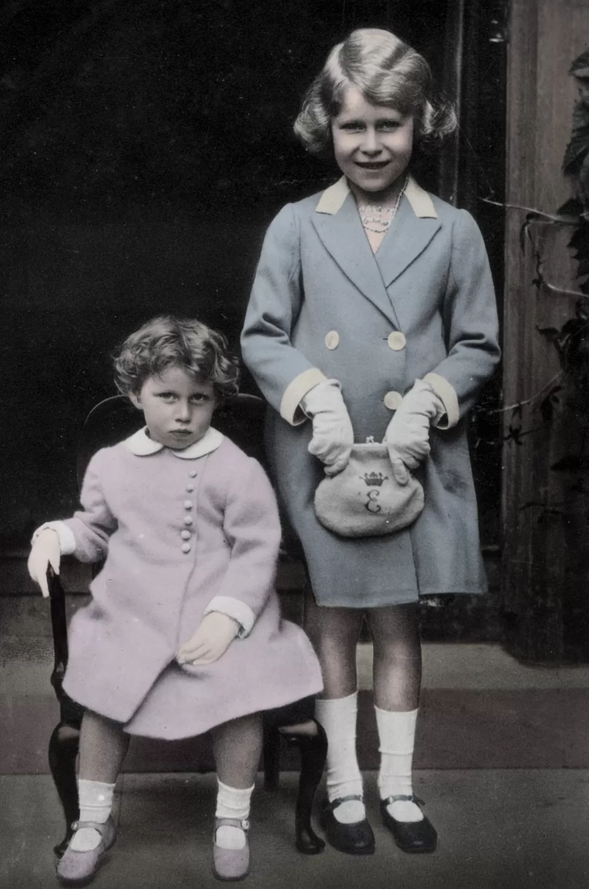
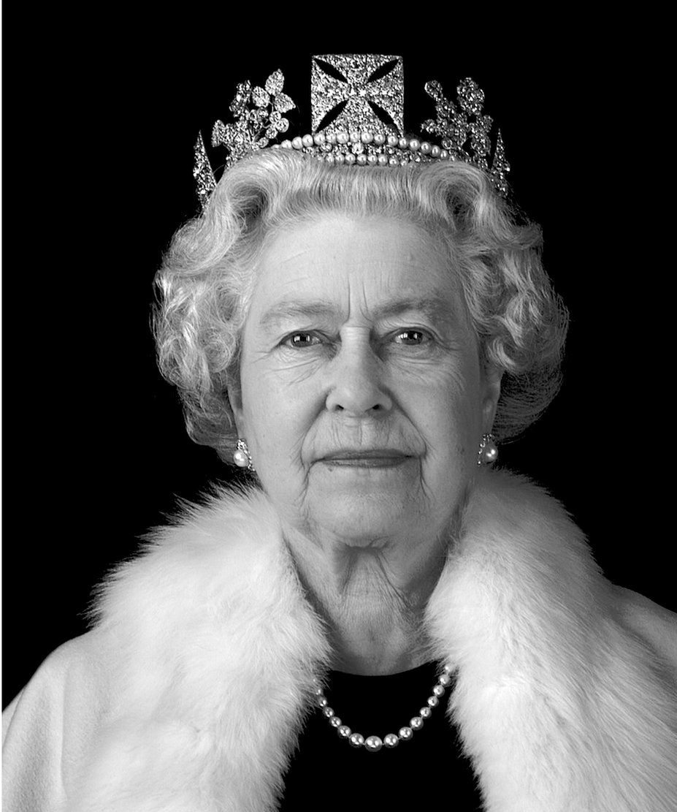
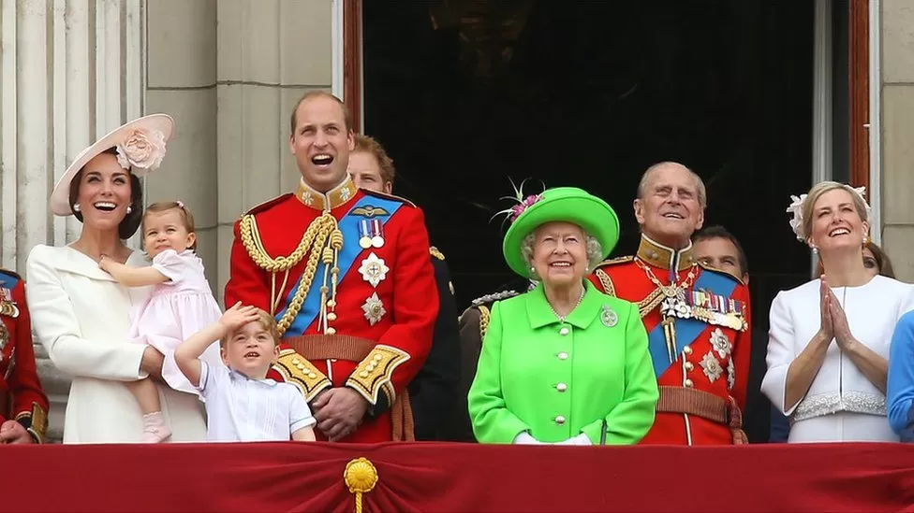
Queen Elizabeth II 1926 - 2022

Slide 2
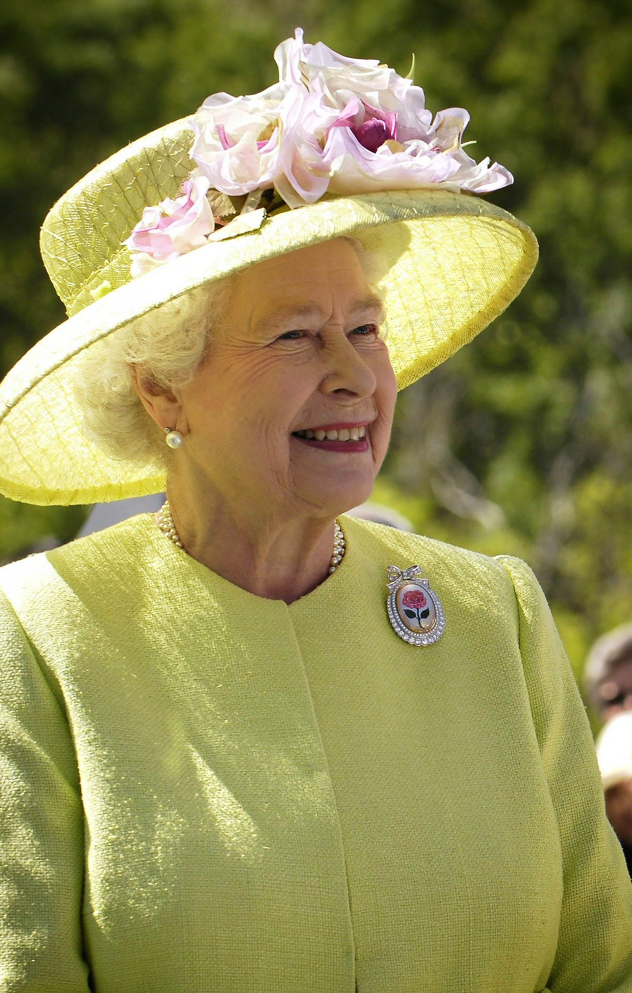
We gather in the name of the Father, and of the Son and of the Holy Spirit. Amen.
Yesterday evening we heard the sad news that Queen Elizabeth II has died at the age of 96.
She had been our queen for over 70 years, leading to great celebrations for her Platinum Jubilee in June this year.

Slide 3
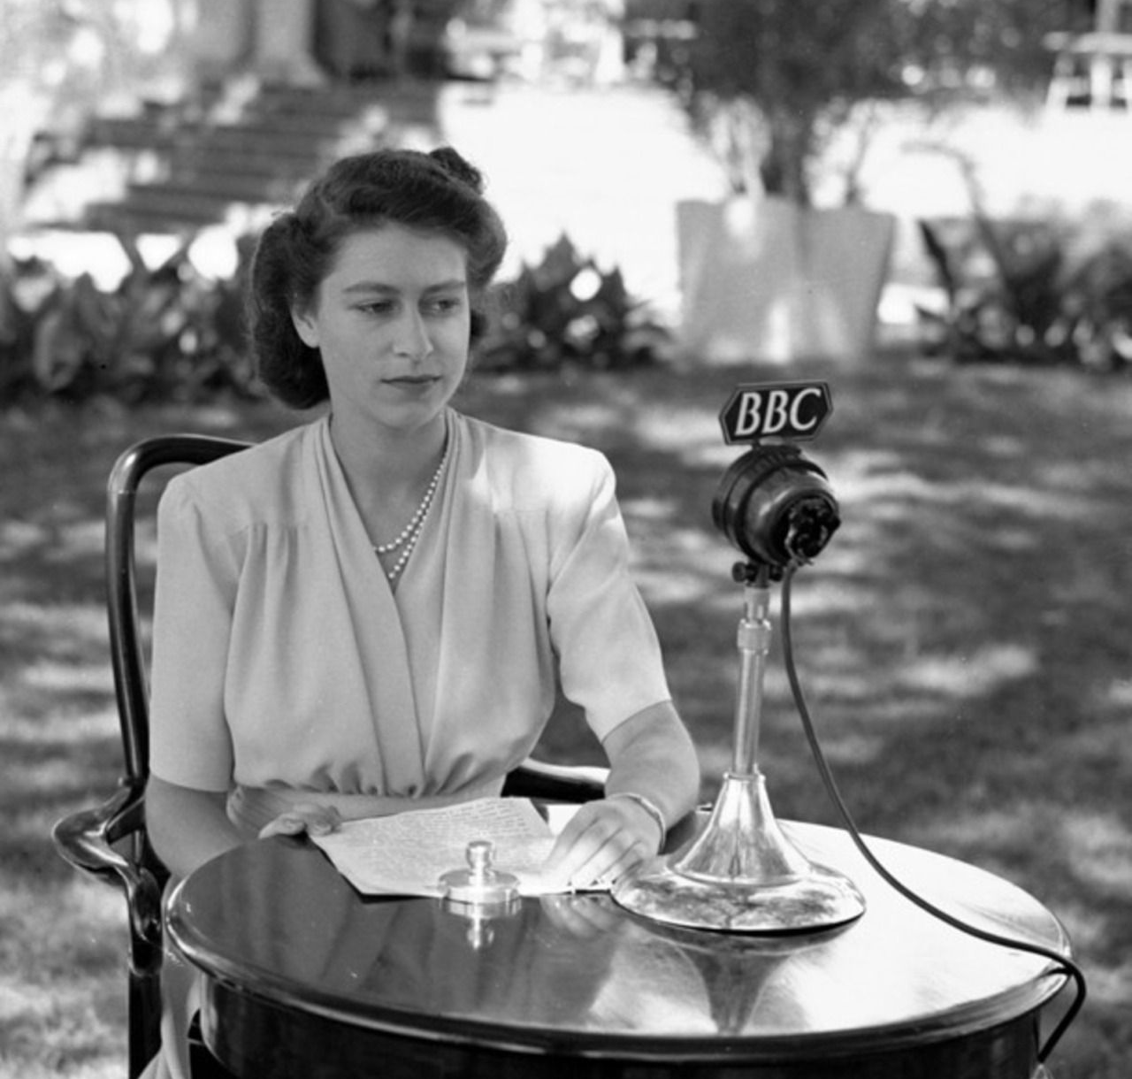
Queen Elizabeth devoted herself to serving her country and serving God.
On her 21st birthday she said,
‘I declare before you all that my whole life, whether it be long or short, shall be devoted to your service and the service of our great imperial family to which we all belong.’

Slide 4
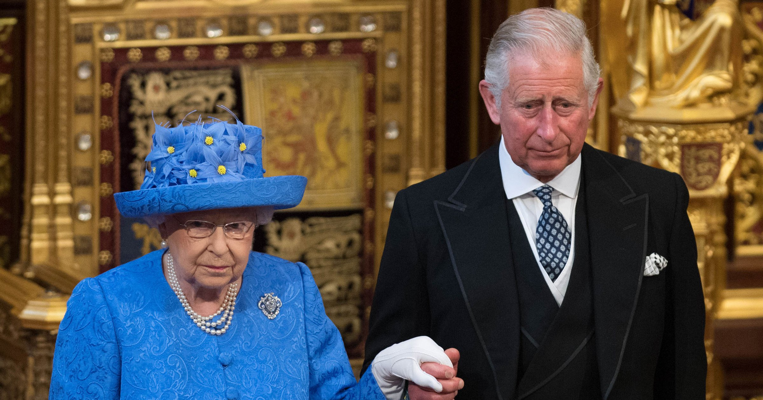
As we gather this morning, we give thanks for her life and pray for her and for all those who mourn her.
We pray too for her eldest son who now becomes King Charles III.

Slide 5
We listen to Saint Paul’s second letter to the Corinthians:
We know that when the tent that we live in on earth is folded up, there is a house built by God for us,
an everlasting home not made by human hands,
in the heavens.
2 Corinthians 5:1

Slide 6
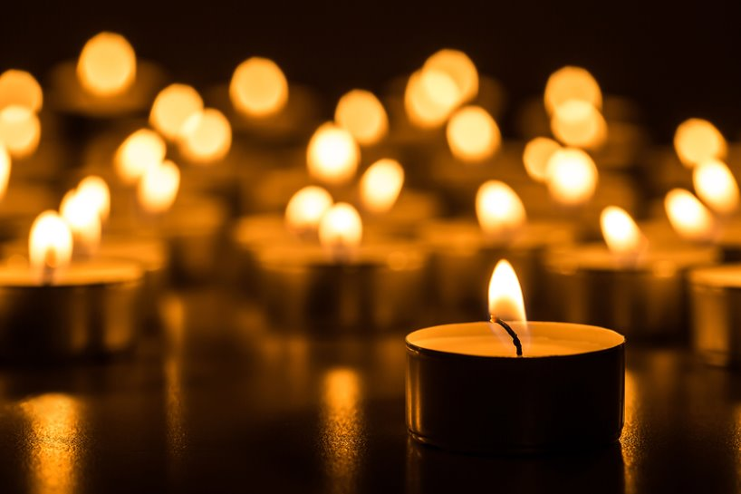
Lord God,
we give thanks for the life of Queen Elizabeth,
for the faith which shaped her life
and the commitment with which she served others.
May her example continue to inspire us all
to bring the Good News of Jesus Christ to others.

Slide 7
We pray too for His Majesty, King Charles III,
as he takes on his new role,
amidst the sadness of mourning his mother.
May he be blessed with wisdom
to govern with justice and humility.

Slide 8
We pray that you will be close to all who mourn today,
bringing strength and peace
by the power of your Holy Spirit.
We make this prayer through Jesus Christ our Lord. Amen.

Slide 9
For Queen Elizabeth we pray together:
All: Eternal rest, grant unto her, O Lord, and let perpetual light shine upon her.
May she rest in peace. Amen.
All: May her soul,
and the souls of all the faithful departed, through the mercy of God,
rest in peace. Amen.

Slide 10
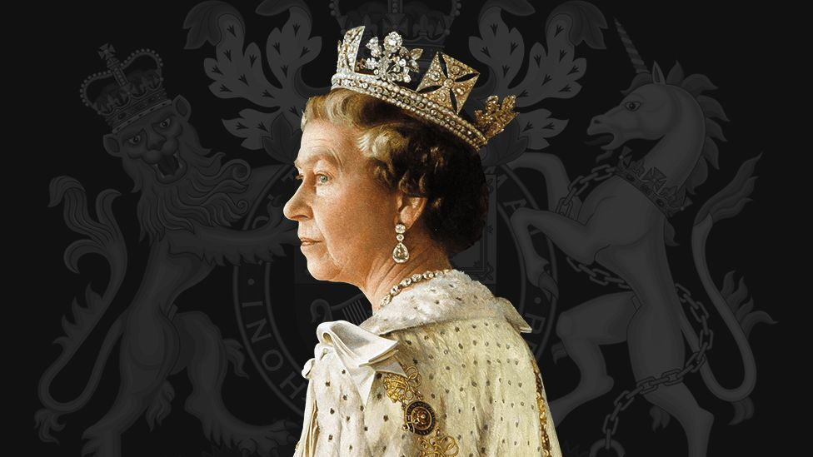
In the name of the Father, and of the Son and of the Holy Spirit. Amen.

