Slide 1
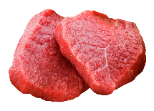
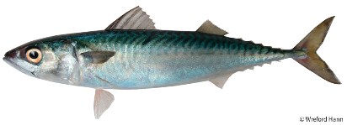
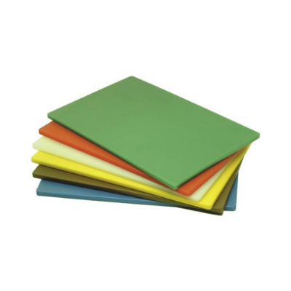
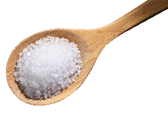
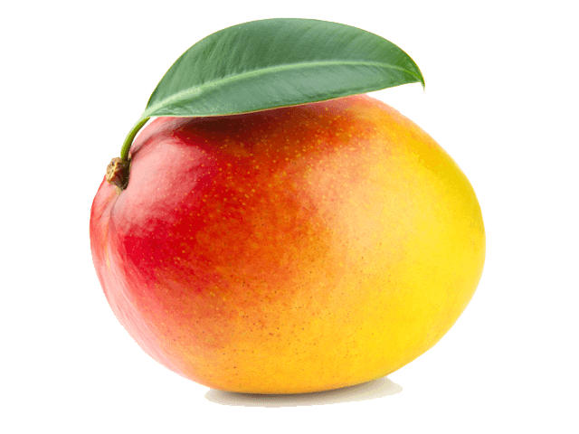
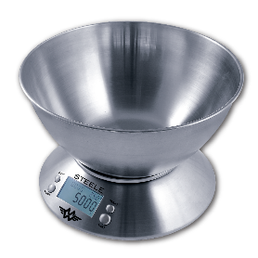
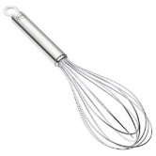
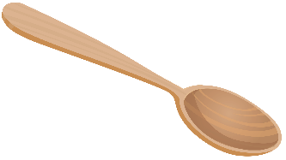
AO3:
Plan, prepare, cook and present dishes, combining appropriate techniques.
AO4:
Analyse and evaluate different aspects of nutrition, food, cooking and preparation
AO1:
Demonstrate knowledge and understanding of nutrition, food, cooking and preparation.
AO2:
Apply knowledge and understanding of nutrition, food, cooking and preparation.
Yr 10 Example of Practical dishes
Lemon Meringue Pie
Portion chicken, chicken fricassee
Pastry making
Jambalaya
Pork Pie
Technical challenge – star bread
Christmas cake
Moussaka
Chelsea buns
Profiteroles
Bakewell Tart
Mission – Attend the Year 11 Leavers' Prom
Knowledge:
Embedding and enhancing knowledge based around scientific principles and nutrition
Consider the format of GCSE AQA exam and refine revision techniques
Non EXAM ASSESSMENT 1
MOCK:
Food Investigation Task
Research
Investigate
Analyse and Evaluate
Revise for and sit your actual GCSEs to give yourself a competitive edge in life
NEA2 – Hand in
NEA1 – Hand in
Complete Y10 mock exam
NEA 2 – Practical exam
Revise for and sit your Y11 mock exams.
NEA Task 1
YEAR
NEA Task 2
11
NEA 1 - Mock Trial 1
Yr 9 Example of Practical dishes
Stir fry
Pizza
Pastry making, Quiche
Joint a chicken, Jerk chicken
Bread
Food styling
Fishcakes
Lasagne
Pavlova
Chicken pie
Risotto, Fresh pasta
Chilli
3.5
Food choice
3.6
Food Provenance
Year 9 Projects
Demonstrate your knowledge of Nutrition and Food Preparation throughout six different projects.
Apply your knowledge of Nutrition and Food preparation through designing and adapting recipes.
Demonstrate skills and techniques in a range of different dishes and cuisines.
Analyse and evaluate results from a range of experiments carried out and through evaluation of dishes.
Use SENACA as a revision tool
Introduction to AQA Food preparation and Nutrition
YEAR
3.4
Food safety
Start your GCSE
Food and Nutrition course
Food Science
Building tech
skills
Commodities
Food Provenance
Nutrition
Diet & Health
Food Choices
10
3.2
Food, nutrition
& health
3.3
Food Science
Preparation:
Develop and refine high level making skills
9
Special diets
Food Safety
YEAR
Demonstrate and Apply Knowledge:
Identify critical temperatures linked to food poisoning bacteria, e.g. the ‘Danger Zone’.
Describe how bacteria multiplies.
Demonstrate Skills and Techniques :
Shortbread
Demonstrate and Apply Knowledge:
Food safety. Link prevention of contamination to prior knowledge of personal hygiene
Demonstrate skills and techniques.
and Apply Knowledge:
Tomato & Basil tart
Demonstrate skills and techniques.
and Apply Knowledge:
Chicken curry.
.
Demonstrate and Apply Knowledge:
Consequences of good and bad hygiene
Assessment. Nutrition and cooking methods
Demonstrate and Apply Knowledge:
Identify hazards and risks in the kitchen
Demonstrate Skills and Techniques :
Scones
Demonstrate Skills and Techniques :
Tomato & Mozz pasta bake
Assessment. Hygiene & Safety
Bread
Technical challenge assessment
Developing technical skills of predominantly savoury foods
YEAR
Demonstrate and apply knowledge.
Determine the relative differences between flours and identify their uses in recipes.
Define ‘added sugars’ and evaluate the negative health implications of eating too much sugar.
Determine the relative differences in gluten content between different types of flour.
Explain the nutritive value of eating poultry.
Understand the scientific process of pastry making
Understanding commodities
8
Demonstrate skills and techniques.
and Apply Knowledge:
Cookies
Attend Options Evening for GCSEs
Recap cooker safety, equipment
Complex knife safety assessment
Apple swans
Recap on Good conduct, contracts, Hygiene & safety, risk assessment
Sensory Analysis
Using senses to describe food
Assessment week:
Assessment – Healthy Eating & The Eatwell Guide
Demonstrate Skills and Techniques :
Small cakes – creaming method
Safe use of the oven
Function of ingredients
Raising agents, aeration
Demonstrate Skills and Techniques :
Fruit Salad
Applying knife skills
Enzymic browning
Baseline Assessment
Recall information from year 7
Where does your food come from
Food miles
Organic
Practical challenge
All wrapped up
Demonstrate and Apply Knowledge:
Nutrients
Functions and Sources.
Importance of a balanced diet
Start of
Focused practical
tasks
Practical
Assessment
Cheese Whirls
Independent focused practical
Analyse and Evaluate:
Reflect on what you have made applying next steps where possible
Demonstrate and Apply Knowledge:
The Eatwell Guide
Hand of Nutrition
introduction to Food and Nutrition
Main nutrients and their function
Demonstrate Skills and Techniques :
Pizza buns
Safe use of a grill
Dextrinisation
Team work
Analyse and Evaluate:
Reflect on what you have made applying next steps where possible
Demonstrate Skills and Techniques :
Rock cakes
Function of ingredients
Rubbing in method
Demonstrate Skills and Techniques :
Carrot cakes
Sausage rolls – Handling raw meat
Cross contamination
Applying knowledge of bacterial growth
Assessment week
Hygiene & safety assessment
& reflection
YEAR
Hygiene & Safety:
Washing up
Using cooker safely
Cooker assessment
7
Demonstrate Skills and Techniques :
Knife safety
Bridge & claw
Knife safety assessment
Weighing & measuring
Hygiene & Safety
Good conduct
Units & equipment
Hygiene & Safety
Risk assessment
4 C’s
Introduction to the Food Room:
Contract
Nosey sheets
Links to Scheme of work.
https://stpaulsleicester-my.sharepoint.com/:f:/g/personal/norton_st-pauls_leicester_sch_uk/Enq2hVGk7ZFAme784nL9ExcBU9mb174kqjsLjylBa4xTXg?e=GWXeBK
Baseline Assessment: what do you already know?
What is the best food experience you have ever had?
Your first Y7 food lesson:

